Slide 1
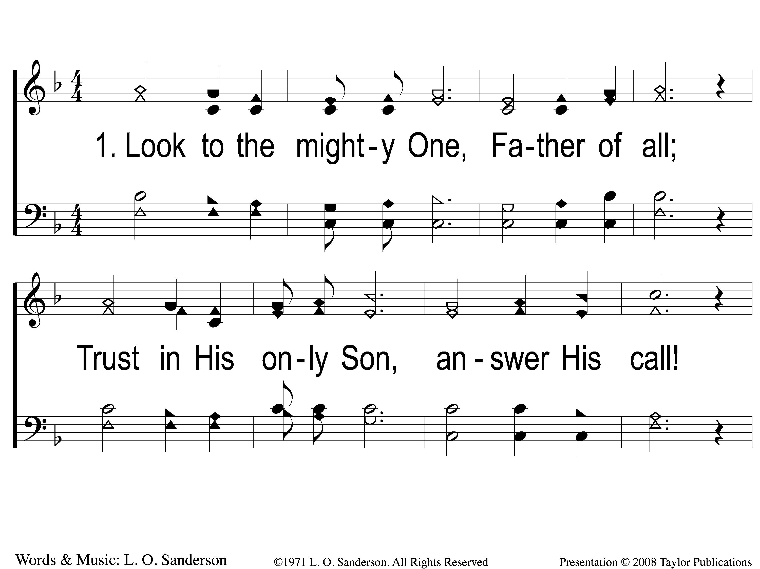
1-1 Exhortation
Exhortation
155

Slide 2
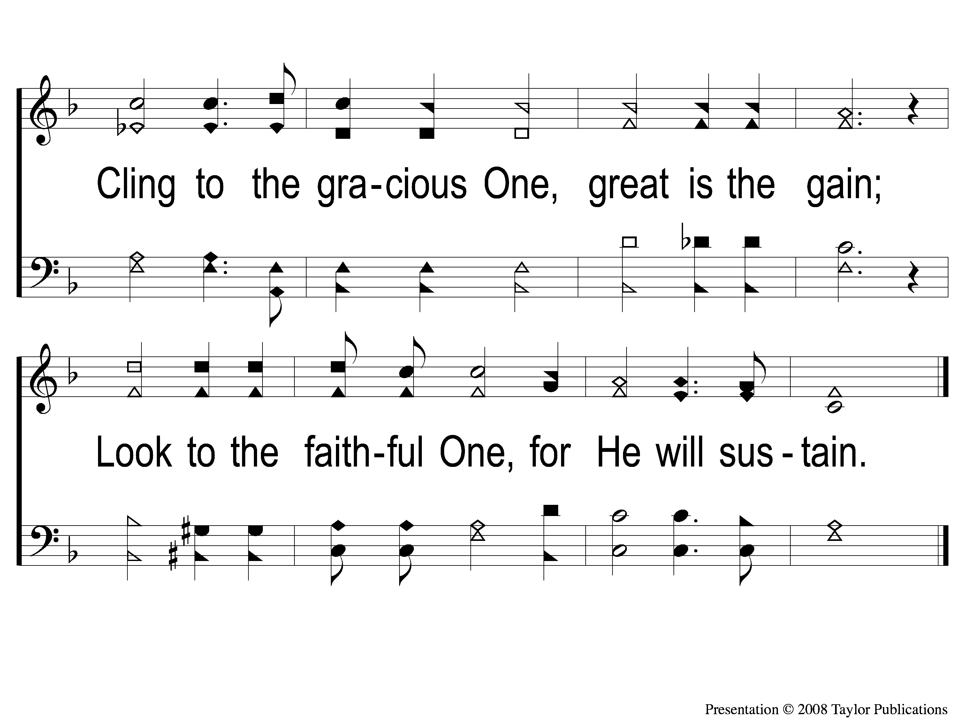
1-2 Exhortation
Exhortation
155

Slide 3
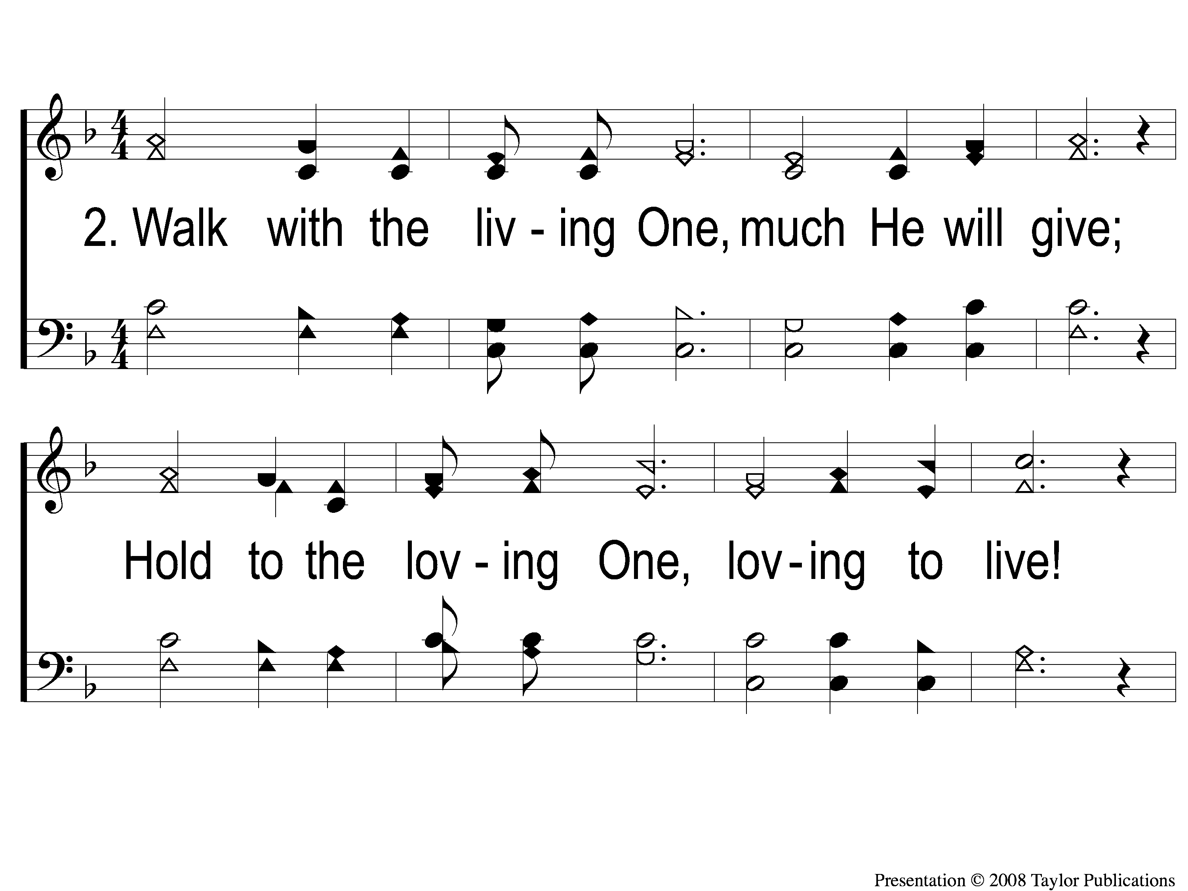
2-1 Exhortation
Exhortation
155

Slide 4
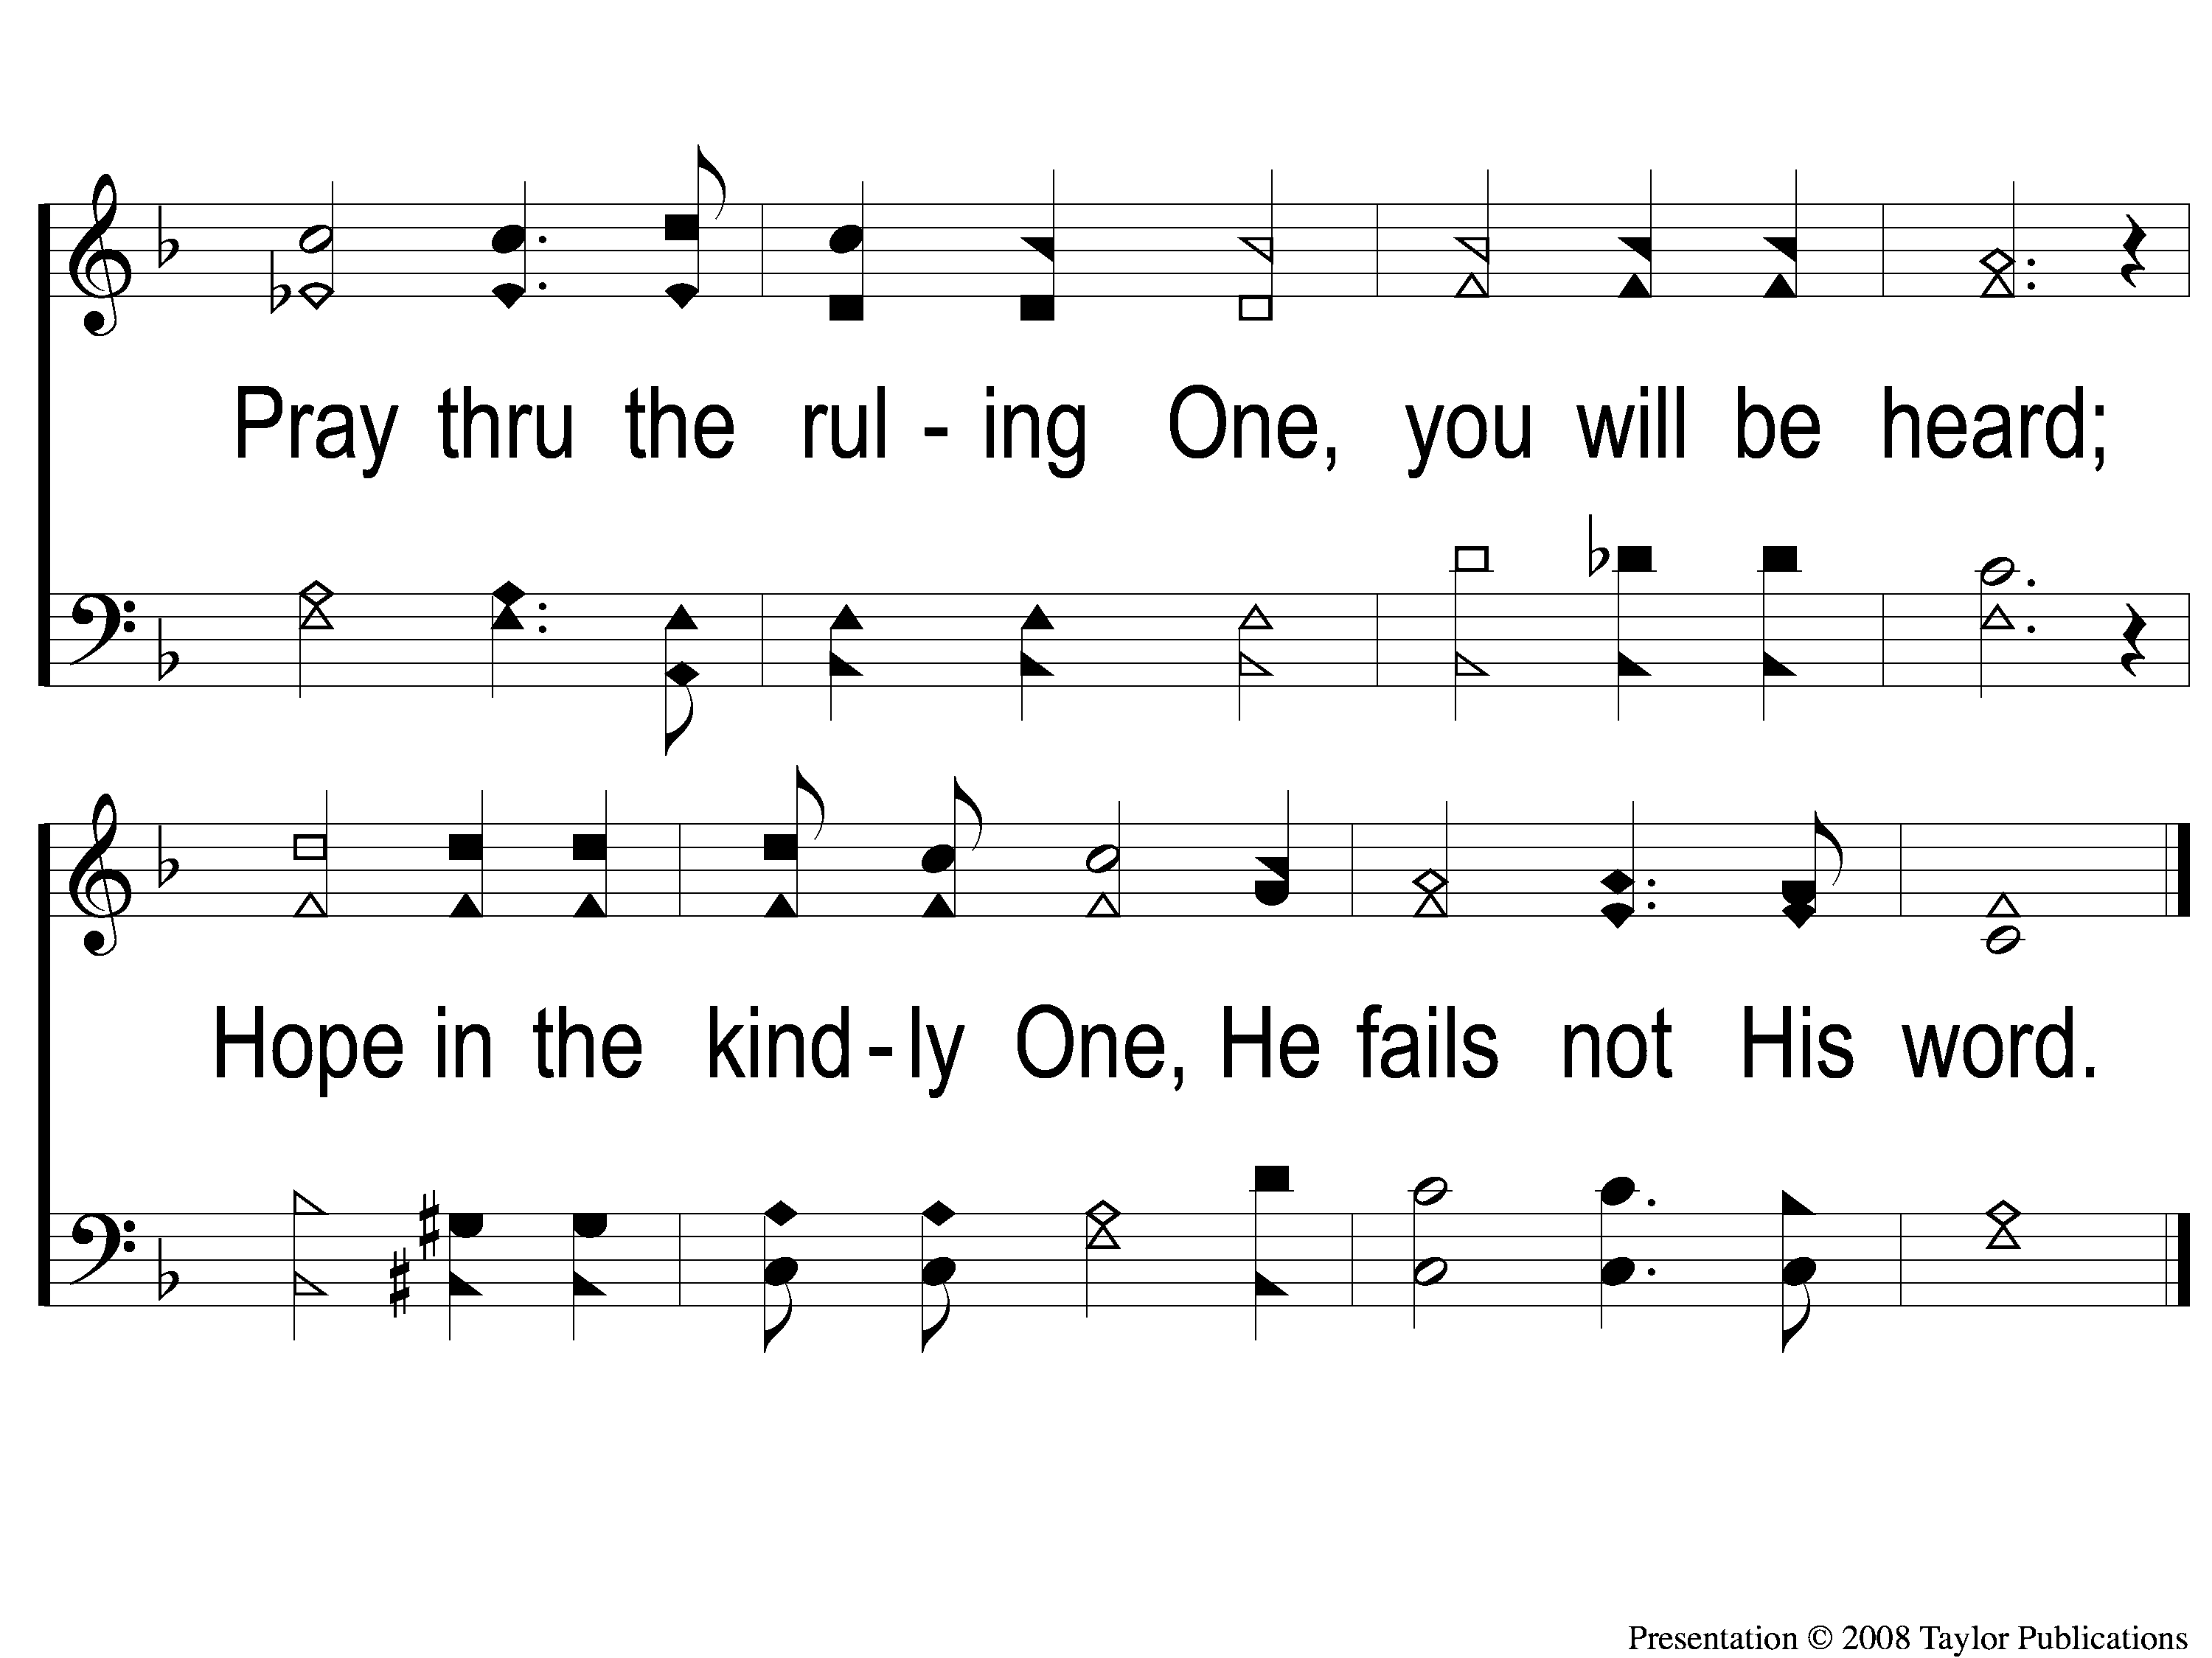
2-2 Exhortation
Exhortation
155

Slide 5
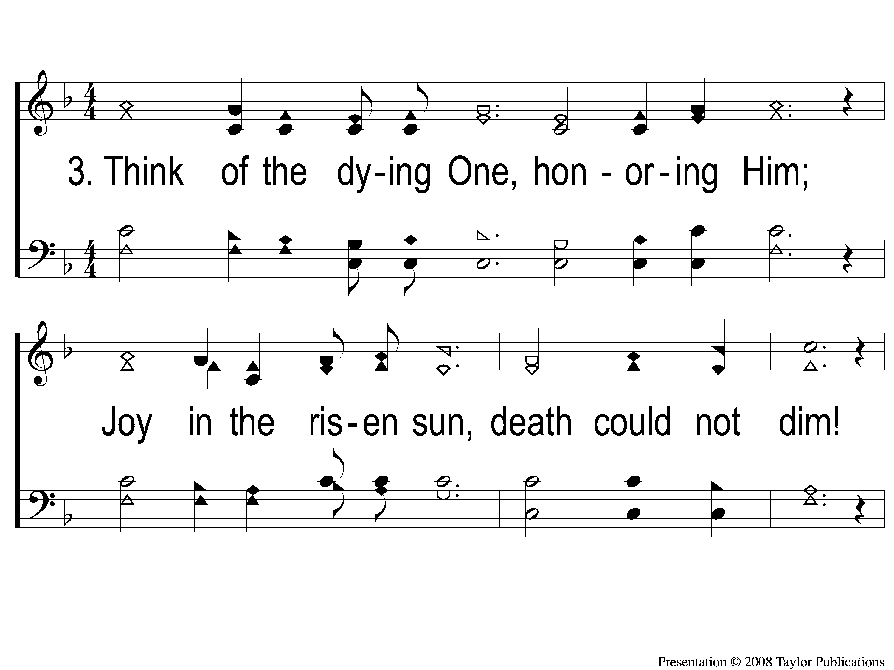
3-1 Exhortation
Exhortation
155

Slide 6
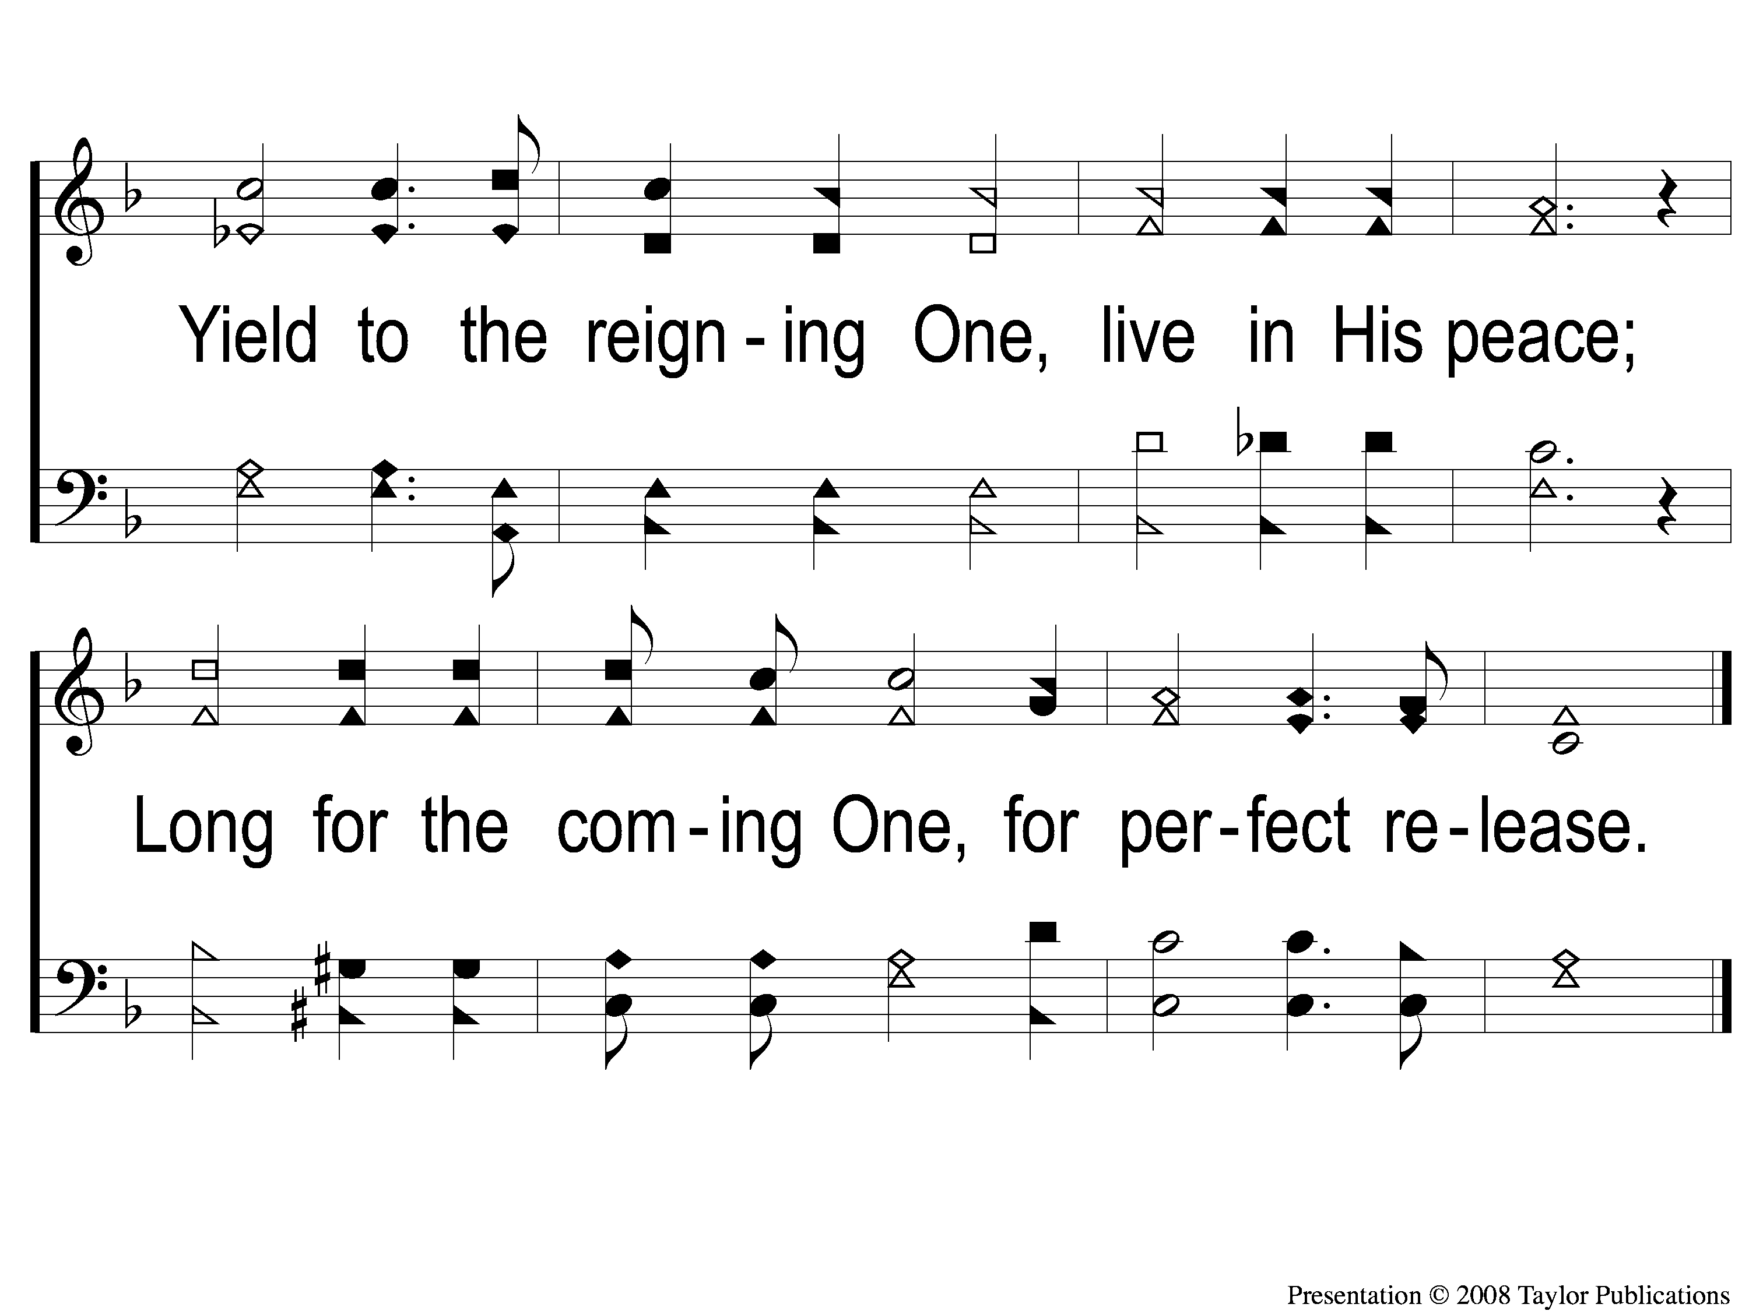
3-2 Exhortation
Exhortation
155

